Slide 1

Unifying RAG and long context LLMs
Lance Martin
Software Engineer, LangChain
@RLanceMartin

Slide 2
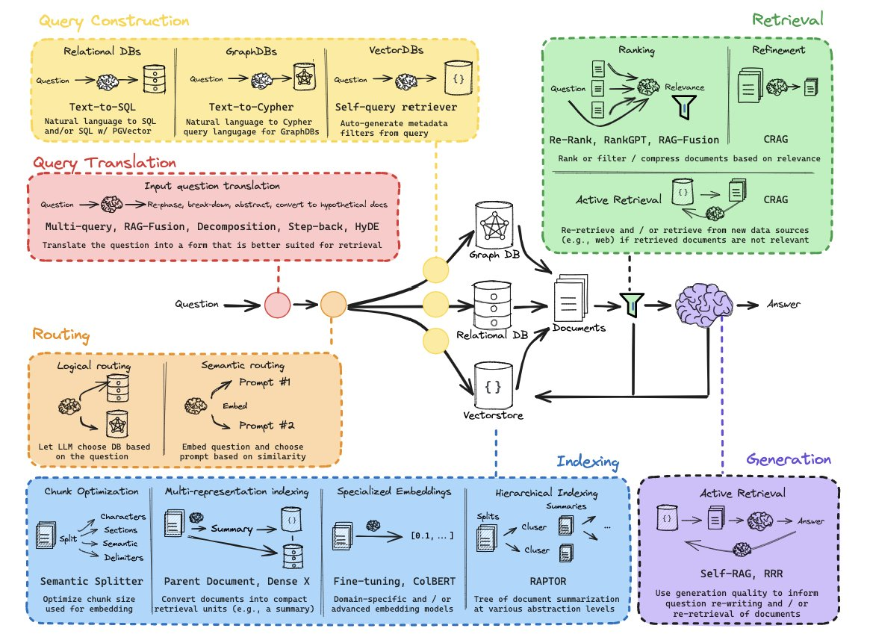
Preface: RAG Course
https://github.com/langchain-ai/rag-from-scratch

Slide 3
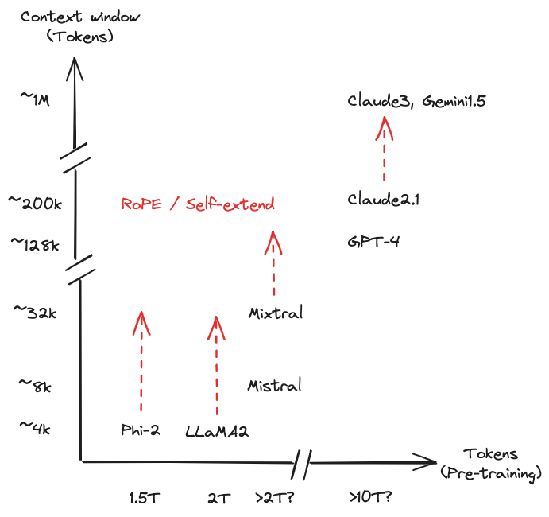
Context windows are getting larger

Slide 4
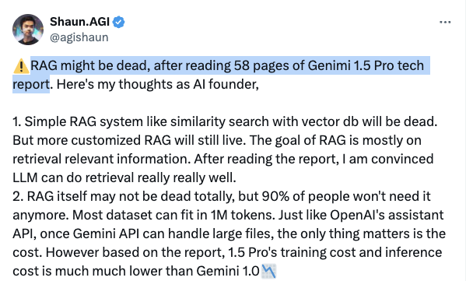
Do we need RAG anymore?
https://twitter.com/agishaun/status/1758561862764122191

Slide 5
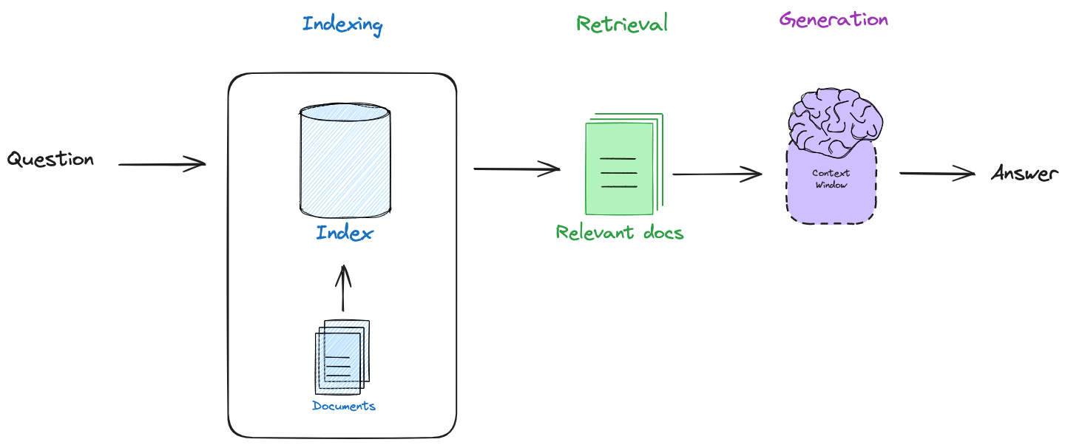
RAG: reasoning & retrieval on multiple chunks of information
https://www.youtube.com/watch?v=wd7TZ4w1mSw

Slide 6
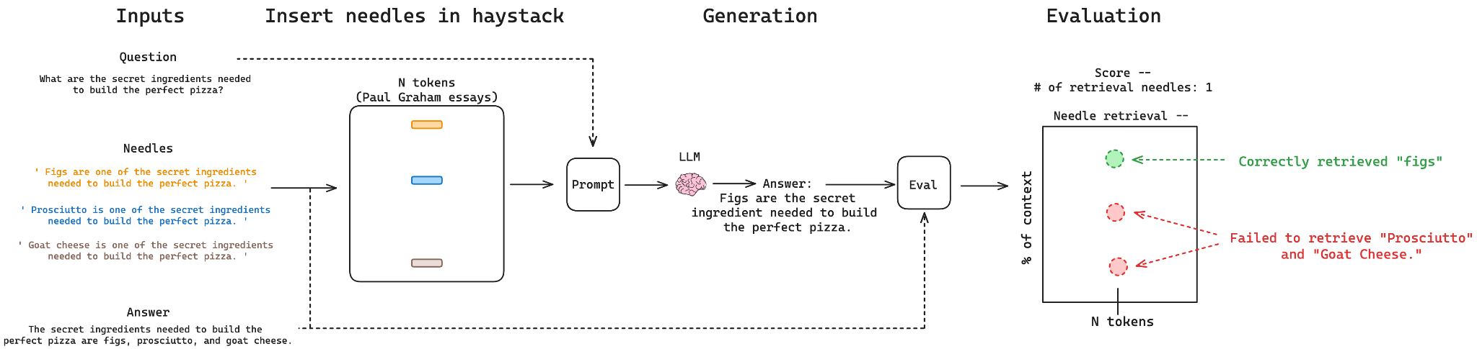
Needle In A Haystack: test reasoning & retrieval in long context LLMs
https://github.com/gkamradt/LLMTest_NeedleInAHaystack

Slide 7
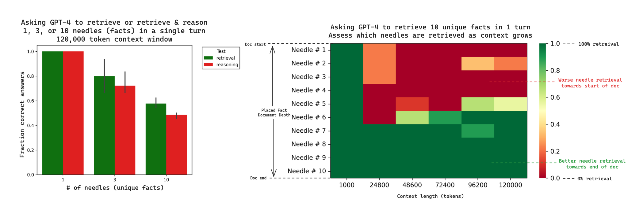
Retrieval is not guaranteed, reasoning harder than retrieval
https://youtu.be/UlmyyYQGhzc
https://blog.langchain.dev/multi-needle-in-a-haystack/

Slide 8
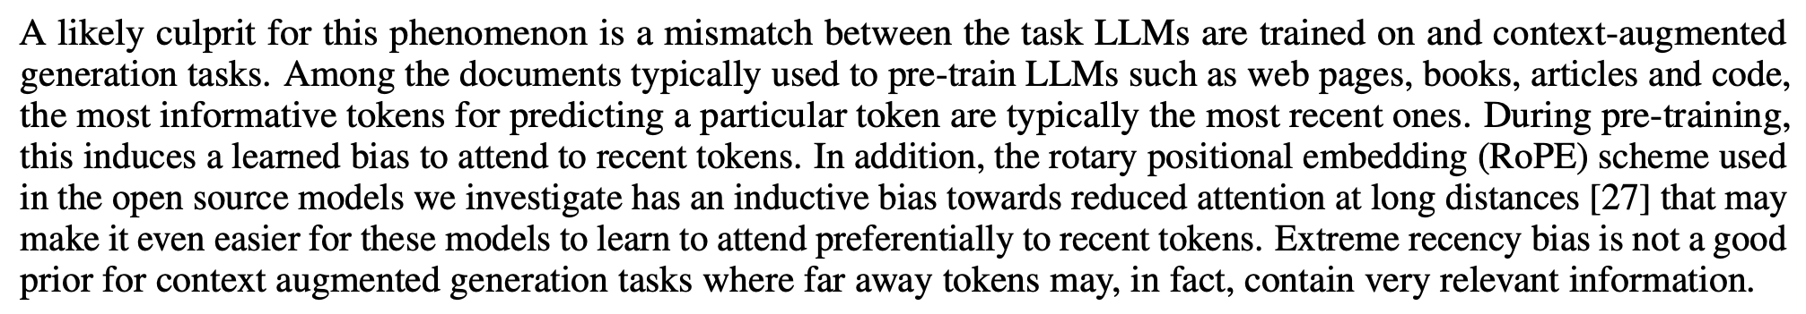
Challenge may be recency bias in LLMs
https://arxiv.org/pdf/2310.01427.pdf

Slide 9
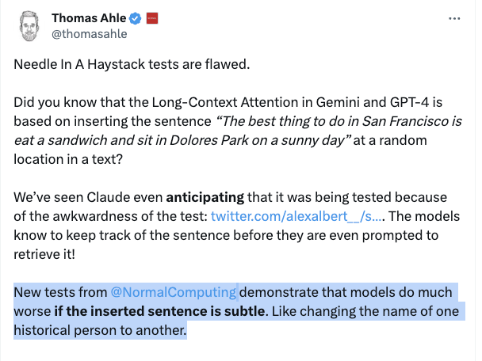
(1) Be wary of context stuffing. No retrieval guarantees.
(2) Single needle may be misleadingly easy (no reasoning, only 1 fact)

Slide 10
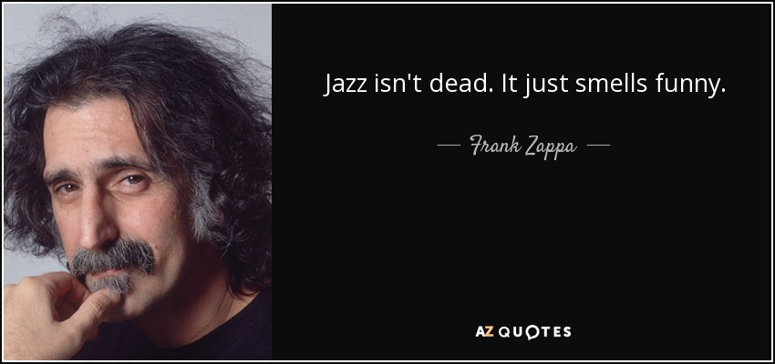
This will obviously get better and RAG will change

Slide 11
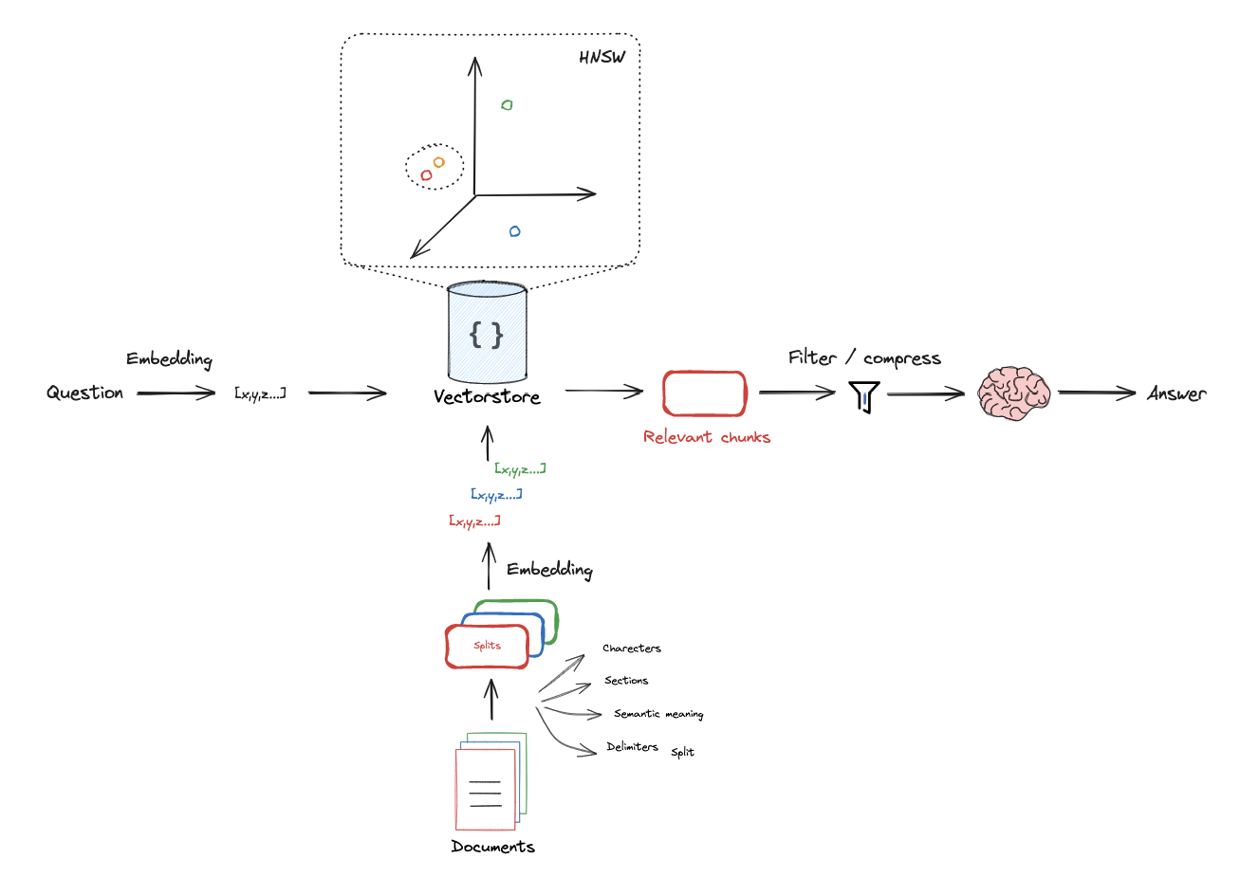
RAG today focused on precise retrieval of relevant doc chunks
https://github.com/langchain-ai/rag-from-scratch

Slide 12
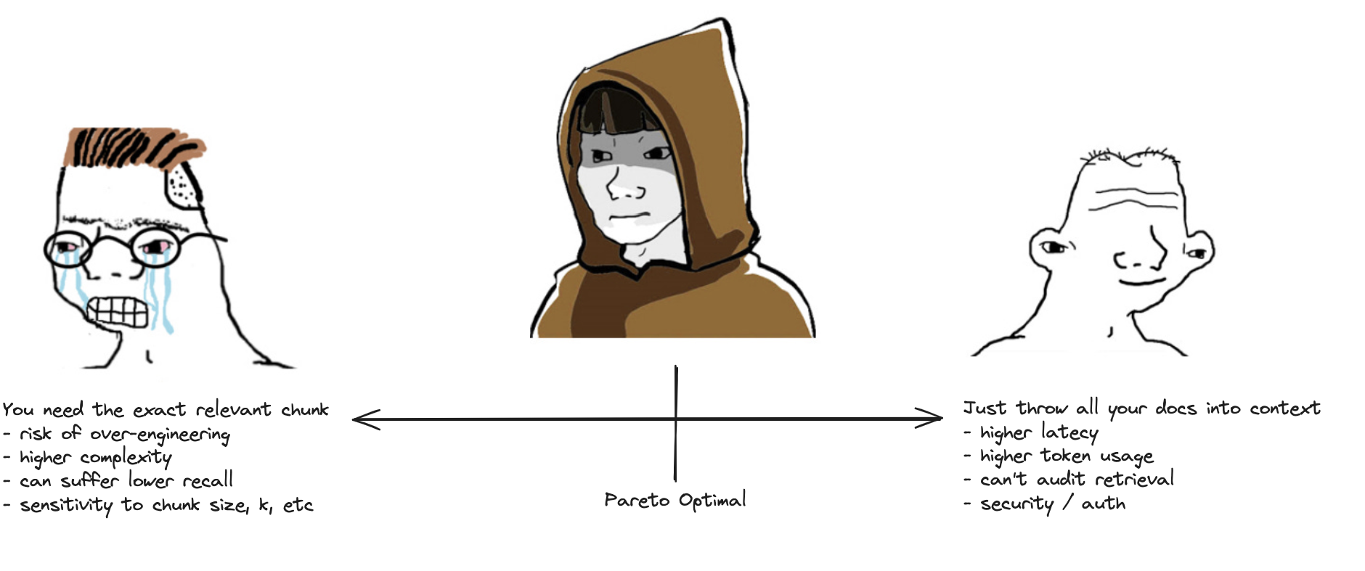
Need to balance system complexity vs latency & token usage

Slide 13
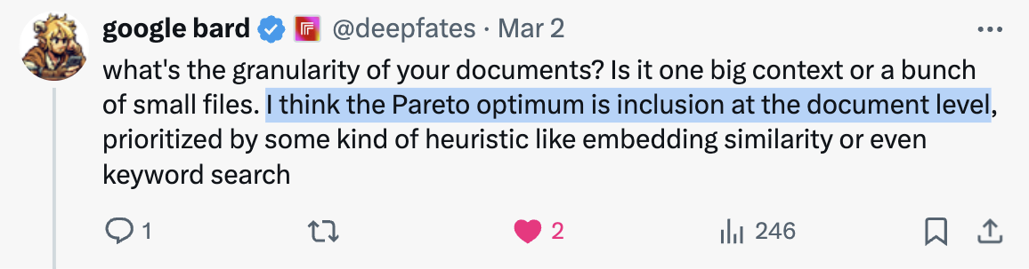
Some ideas …
https://x.com/RLanceMartin/status/1764018419618484325?s=20

Slide 14
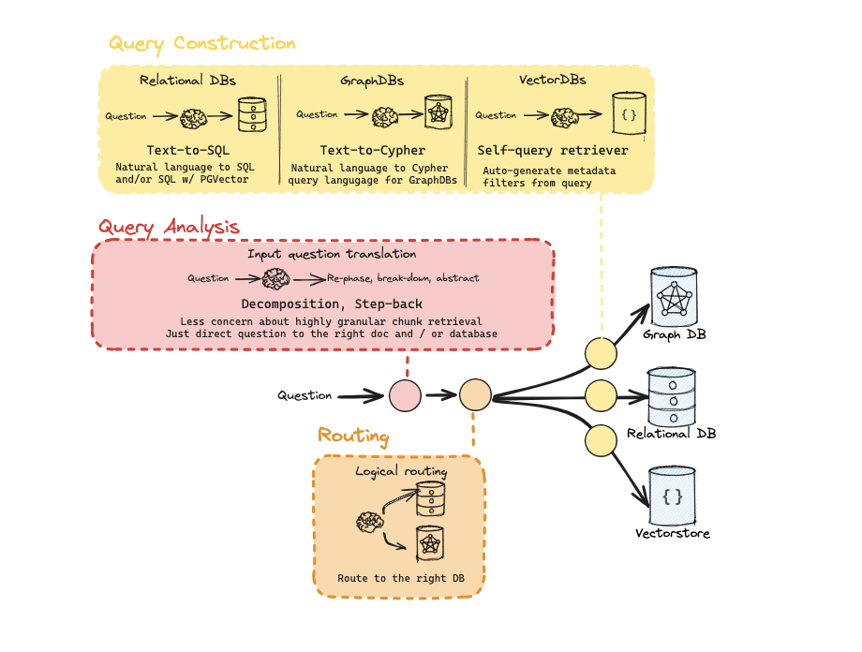
Query analysis: Connect questions to the right document
https://python.langchain.com/docs/use_cases/query_analysis/

Slide 15
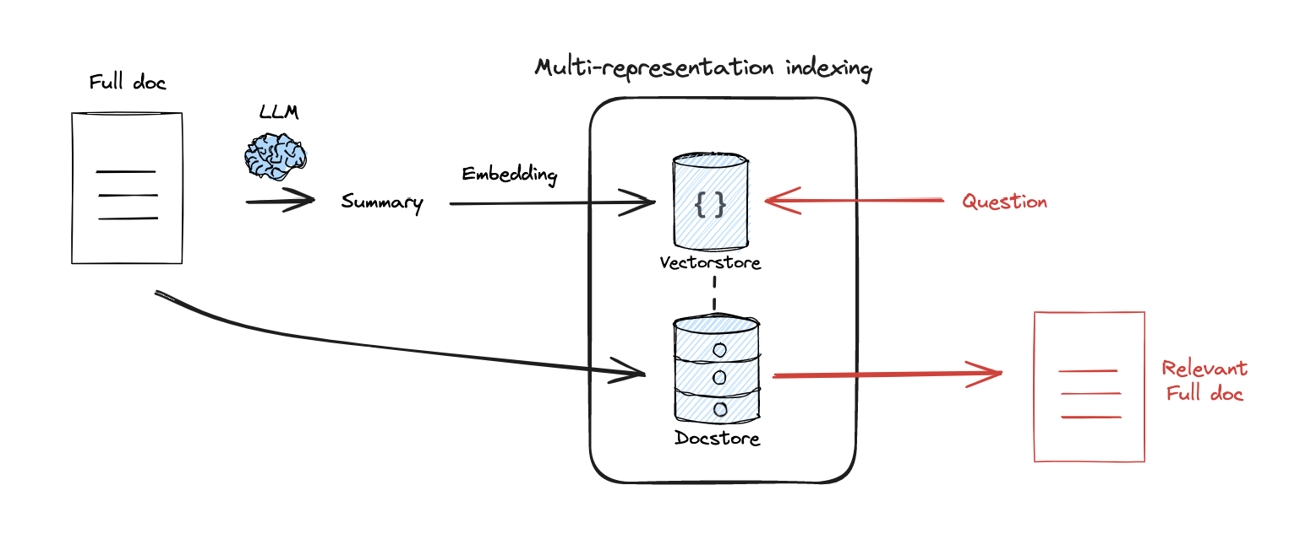
Indexing: Use representations to simplify document retrieval
https://arxiv.org/pdf/2312.06648.pdf
https://blog.langchain.dev/semi-structured-multi-modal-rag/
https://python.langchain.com/docs/modules/data_connection/retrievers/parent_document_retriever
Notes:
Share redis seminar
Share multi-modal

Slide 16
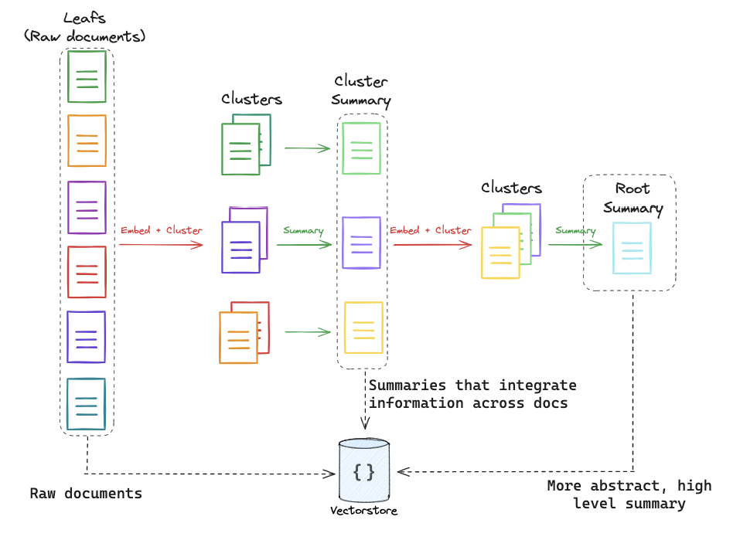
Indexing: Use trees to consolidate info across many documents
https://arxiv.org/abs/2401.18059
https://www.youtube.com/watch?v=jbGchdTL7d0

Slide 17
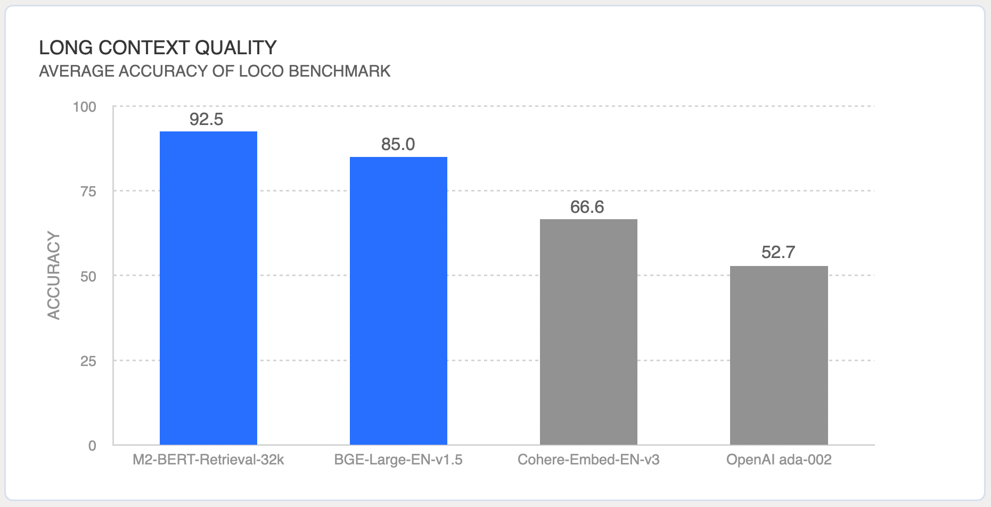
Indexing: Use long context embeddings
https://www.together.ai/blog/embeddings-endpoint-release
https://hazyresearch.stanford.edu/blog/2024-01-11-m2-bert-retrieval
Notes:
32k quality?

Slide 18
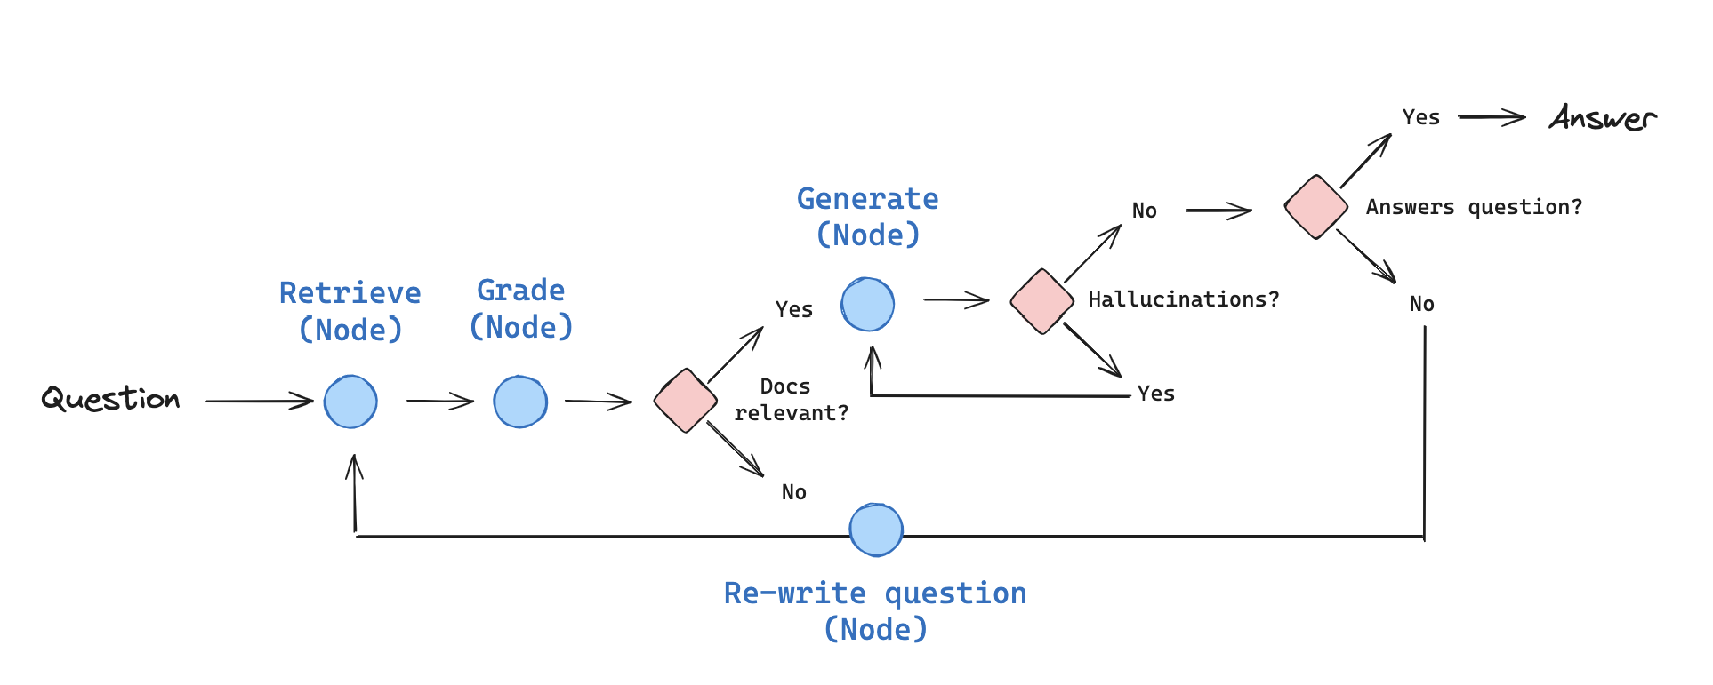
Reasoning: Use reasoning / self-reflection around RAG
https://arxiv.org/abs/2310.11511
https://www.youtube.com/watch?v=E2shqsYwxck
https://github.com/langchain-ai/langgraph/blob/main/examples/rag/langgraph_self_rag.ipynb
Notes:
Latency w/ self-RAG?

Slide 19
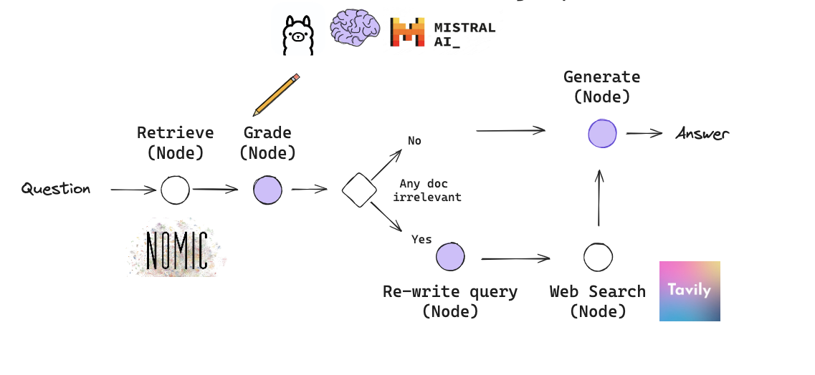
Reasoning: Use reasoning / self-reflection around RAG
https://arxiv.org/abs/2401.15884
https://www.youtube.com/watch?v=E2shqsYwxck
https://github.com/langchain-ai/langgraph/blob/main/examples/rag/langgraph_crag.ipynb
Notes:
Latency w/ self-RAG?

Slide 20
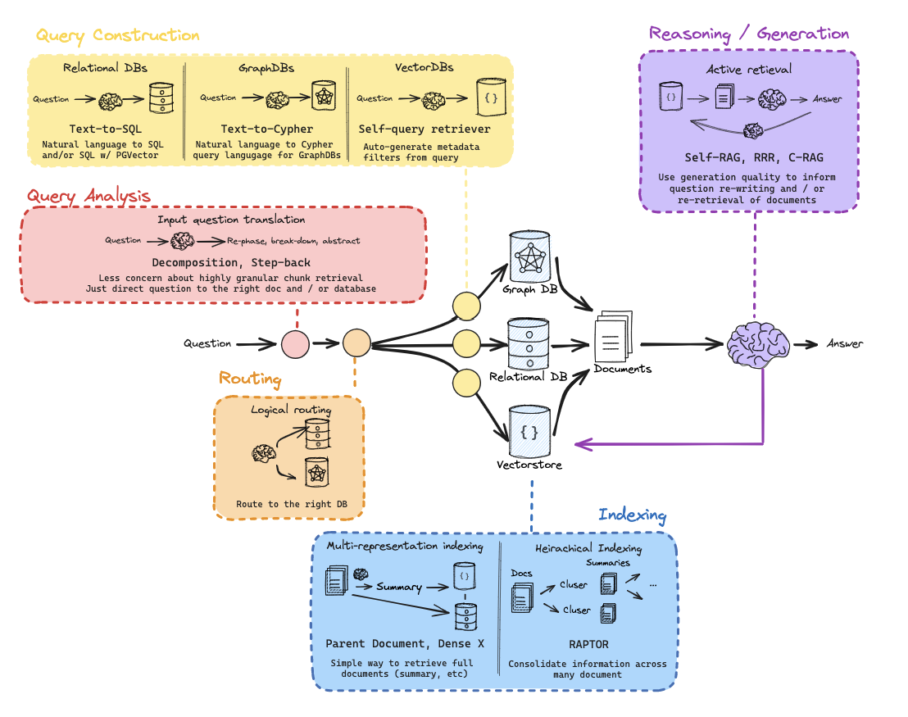
Overall picture: Doc-centric, no splits or compression, reason pre/post retrieval

